Slide 1
Randomized experiments
Modeling Social Data
Jake Hofman
Columbia University

Slide 2
Prediction
Make a forecast, leaving the world as it is
(seeing my neighbor with an umbrella might predict rain)
vs.
Causation
Anticipate what will happen when you make a change in the world
(but handing my neighbor an umbrella doesn’t cause rain)

Slide 3
“Causes of effects”
It’s tempting to ask “what caused Y”, e.g.
What makes an email spam?
What caused my kid to get sick?
Why did the stock market drop?
This is ”reverse causal inference”, and is generally quite hard
John Stuart Mill (1843)

Slide 4
“Effects of causes”
Alternatively, we can ask “what happens if we do X?”, e.g.
How does education impact future earnings?
What is the effect of advertising on sales?
How does hospitalization affect health?
This is “forward causal inference”: still hard, but less contentious!
John Stuart Mill (1843)

Slide 5
Example: Hospitalization on health
What’s wrong with estimating this model from observational data?
Hospital visit today
Health tomorrow
Effect?
Arrow means “X causes Y”

Slide 6
Confounds
The effect and cause might be confounded by a common cause, and be changing together as a result
Health today
Hospital visit today
Health tomorrow
Effect?
Dashed circle means “unobserved”

Slide 7
Confounds
If we only get to observe them changing together, we can’t estimate the effect of hospitalization changing alone
Health today
Hospital visit today
Health tomorrow
Effect?

Slide 8
Observational estimates
Let’s say all sick people in our dataset went to the hospital today, and healthy people stayed home
The observed difference in health tomorrow is:
Δ_{obs} = (Sick and went to hospital) – (Healthy and stayed home)

Slide 9
Observational estimates
Let’s say all sick people in our dataset went to the hospital today, and healthy people stayed home
The observed difference in health tomorrow is:
Δ_{obs} = [(Sick and went to hospital) – (Sick if stayed home)] +
[(Sick if stayed home) - (Healthy and stayed home)]

Slide 10
Selection bias
Let’s say all sick people in our dataset went to the hospital today, and healthy people stayed home
The observed difference in health tomorrow is:
Δ_{obs} = [(Sick and went to hospital) – (Sick if stayed home)] +
[(Sick if stayed home) - (Healthy and stayed home)]
Causal effect
Selection bias
(Baseline difference between those who opted in to the treatment and those who didn’t)

Slide 11
Basic identity of causal inference¹
Let’s say all sick people in our dataset went to the hospital today, and healthy people stayed home
The observed difference in health tomorrow is:
Observed difference = Causal effect – Selection bias
Selection bias is likely negative here, making the observed difference an underestimate of the causal effect
¹Varian (2016)

Slide 12
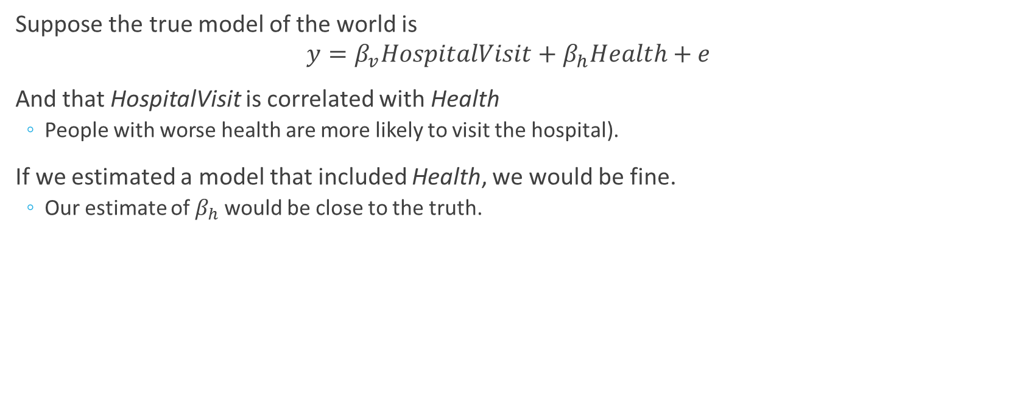
Population Equation
Suppose the true model of the world is
$$y=β_{v}HospitalVisit+β_{h}Health+e$$
And that HospitalVisit is correlated with Health
People with worse health are more likely to visit the hospital).
If we estimated a model that included Health, we would be fine.
Our estimate of $β_{h}$ would be close to the truth.

Slide 13
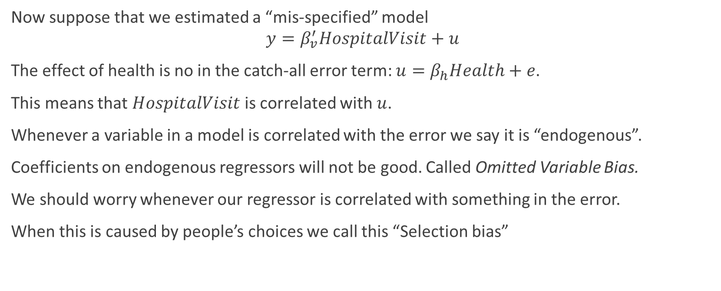
Omitted Variable Bias
Now suppose that we estimated a “mis-specified” model
$$y=β_{v}^{′}HospitalVisit+u$$
The effect of health is no in the catch-all error term: $u=β_{h}Health+e$.
This means that $HospitalVisit$ is correlated with $u$.
Whenever a variable in a model is correlated with the error we say it is “endogenous”.
Coefficients on endogenous regressors will not be good. Called Omitted Variable Bias.
We should worry whenever our regressor is correlated with something in the error.
When this is caused by people’s choices we call this “Selection bias”

Slide 14
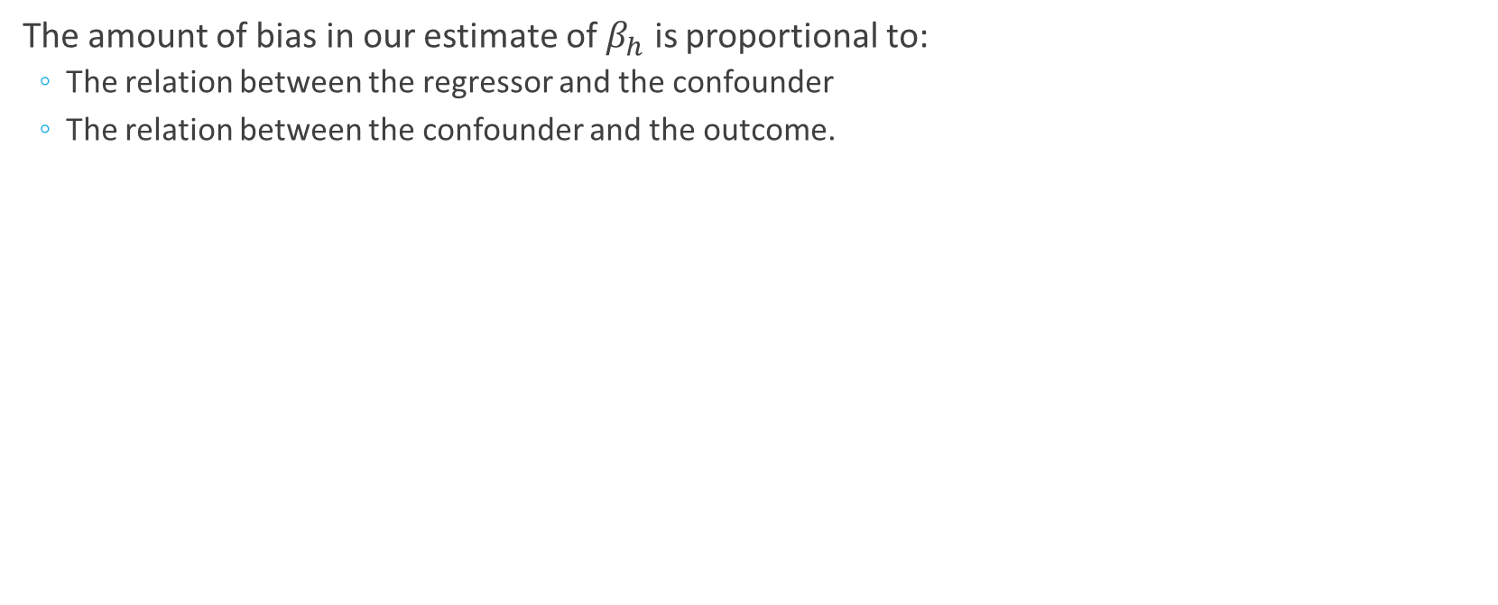
OVB
The amount of bias in our estimate of $β_{h}$ is proportional to:
The relation between the regressor and the confounder
The relation between the confounder and the outcome.

Slide 15
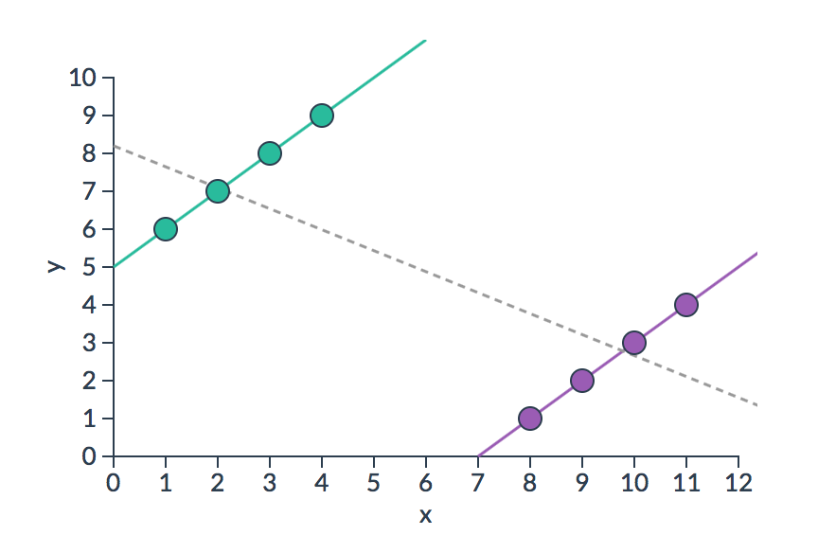
Simpson’s paradox
Selection bias can be so large that observational and causal estimates give opposite effects (e.g., going to hospitals makes you less healthy)
http://vudlab.com/simpsons

Slide 16
Simpson’s Paradox: Batting Averages
 | 1995 |  | 1996 |  | Combined
Derek Jeter | 12/48 | .250 | 183/582 | .314 | 195/630 | .310
David Justice | 104/411 | .253 | 45/140 | .321 | 149/551 | .270

Slide 17
“To find out what happens when you change something, it is necessary to change it.”
-George Box

Slide 18
Random assignment
Random assignment determines the treatment independent of any confounds
Health today
Coin flip
Hospital visit today
Health tomorrow
Effect?
Double lines mean “intervention”

Slide 19



Counterfactuals
To isolate the causal effect, we have to change one and only one thing (hospital visits), and compare outcomes
Reality
Counterfactual
+
vs
(what happened)
(what would have happened)

Slide 20
Counterfactuals
We never get to observe what would have happened if we did something else, so we have to estimate it
Reality
Counterfactual
+
vs
(what happened)
(what would have happened)
Notes:
What we’d like to do is to make a copy of the world

Slide 21

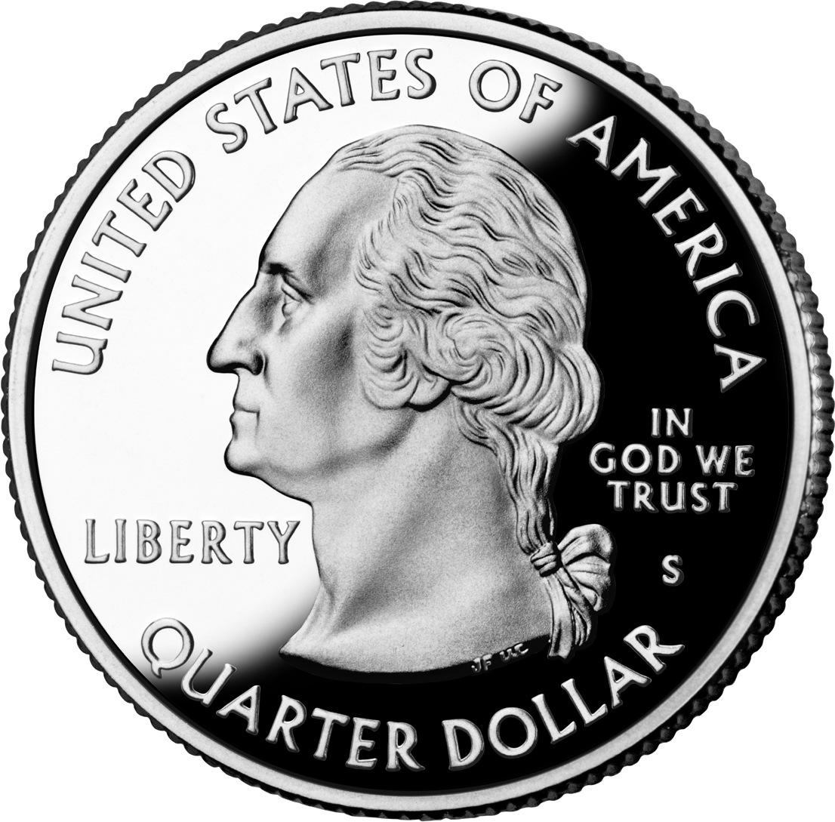
Random assignment
We can use randomization to create two groups that differ only in which treatment they receive, restoring symmetry
World 1
World 2
Heads
Tails
+

Slide 22

Random assignment
We can use randomization to create two groups that differ only in which treatment they receive, restoring symmetry
World 1
World 2
Heads
Tails
+

Slide 23
Random assignment
We can use randomization to create two groups that differ only in which treatment they receive, restoring symmetry
World 1
World 2
+

Slide 24
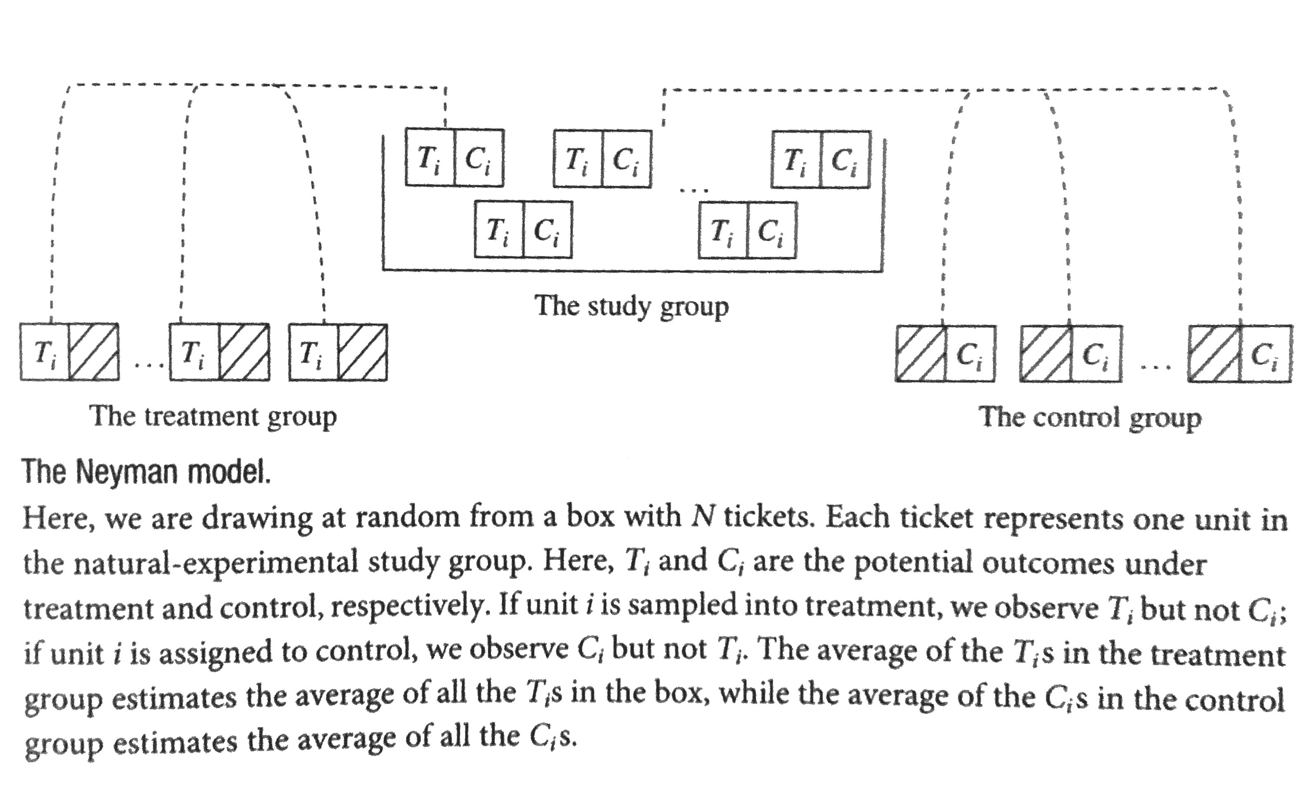
Random assignment
Dunning (2012)

Slide 25
Basic identity of causal inference
The observed difference is now the causal effect:
Observed difference = Causal effect – Selection bias
= Causal effect
Selection bias is zero, since there’s no difference, on average, between those who were hospitalized and those who weren’t

Slide 26
Experimental Design
What is the Treatment and what is the control? Is there a placebo?
At what level is this randomized (participant, cluster)?
What do I want to measure? Can I measure it effectively (e.g. privacy concerns)?
Blinding: Participants and experimental workers should not know whether in control or treatment?

Slide 27
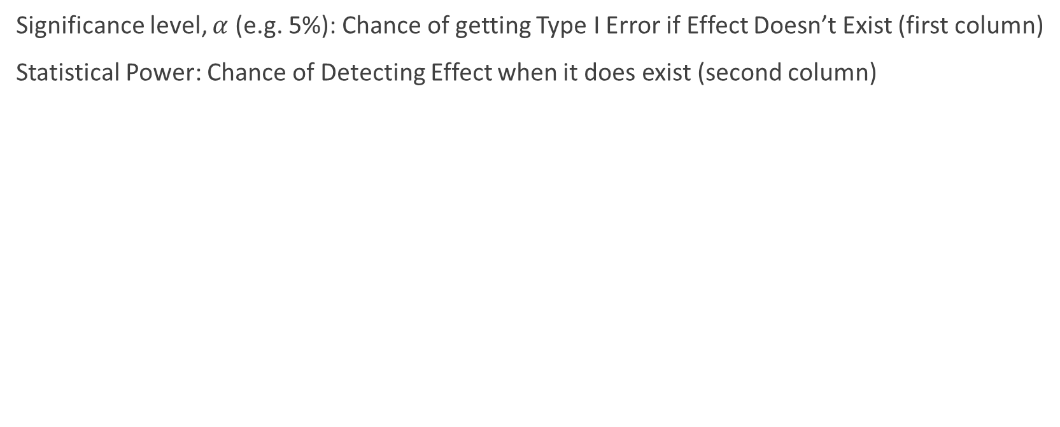
Statistical Review
Significance level, $α$ (e.g. 5%): Chance of getting Type I Error if Effect Doesn’t Exist (first column)
Statistical Power: Chance of Detecting Effect when it does exist (second column)
 | Effect Doesn’t Exists | Effect Exist
Detect Effect | Type I Error (False Positive) | True Positive
Don’t Detect Effect | True Negative | Type II Error (False Negative)

Slide 28
Visualizations
Cohen’s d: http://rpsychologist.com/d3/cohend/
Power & Statistical Significance: http://rpsychologist.com/d3/NHST/

Slide 29
Types of validity
Internal Validity
Did I correctly estimate the effect in my sample?
Did I not control for a confounder?
External Validity
Will this effect hold elsewhere?
Did I study a population that is very unique?
These answer did I learn anything potentially useful?

Slide 30
Problems
Random assignment is the “gold standard” for causal inference, but can be misleading under certain circumstances
Small sample sizes
Researcher degrees of freedom
Publication bias
P-hacking

Slide 32
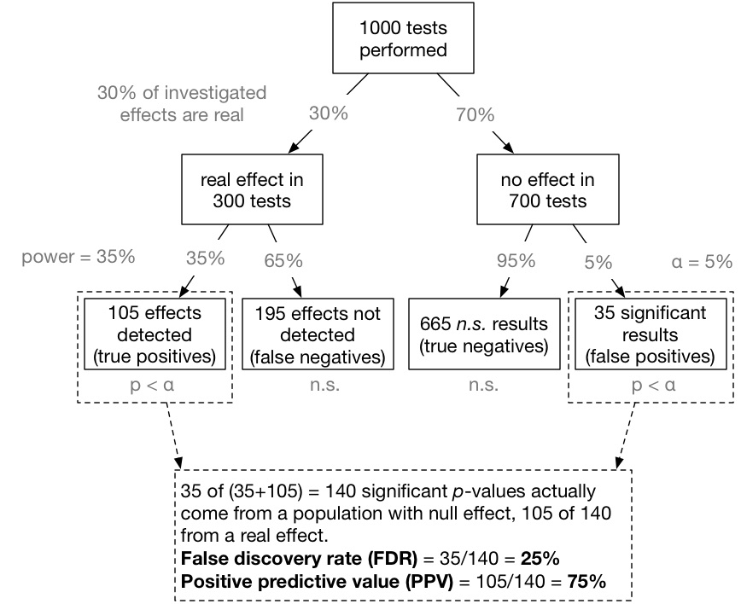
http://bit.ly/fdrtree

Slide 37
Caveats / limitations
Random assignment is the “gold standard” for causal inference, but it has some limitations:
Randomization often isn’t feasible and/or ethical
Experiments are costly in terms of time and money
It’s difficult to create convincing parallel worlds
Inevitably people deviate from their random assignments
Anyone can flip a coin, but it’s difficult to create convincing parallel worlds

Slide 41
Closing thoughts
Large-scale observational data is useful for building predictive models of a static world

Slide 42
Closing thoughts
But without appropriate random variation, it’s hard to predict what happens when you change something in the world

Slide 43
Closing thoughts
Randomized experiments are like custom-made datasets to answer a specific question

Slide 44
Preview: Natural experiments

Slide 45
Natural experiments
Sometimes we get lucky and nature effectively runs experiments for us, e.g.:
As-if random: People are randomly exposed to water sources
Instrumental variables: A lottery influences military service
Discontinuities: Star ratings get arbitrarily rounded
Difference in differences: Minimum wage changes in just one state

Slide 46
Natural experiments
Sometimes we get lucky and nature effectively runs experiments for us, e.g.:
As-if random: People are randomly exposed to water sources
Instrumental variables: A lottery influences military service
Discontinuities: Star ratings get arbitrarily rounded
Difference in differences: Minimum wage changes in just one state
Experiments happen all the time, we just have to notice them

